Slide 1
Project Website

Slide 2
Outline
Set up the Report Website
Environment
WordPress
Report Content

Slide 3

How to Set Up a Report Website
You can use whatever is convenient
Blog System: WordPress
CMS : Joomla, Drupal
Wiki: MediaWiki
Others: Redmine (for project management), Jekyll (static, markdown)
WordPress is the most widely used blog system in the world and in our lab

Slide 4
Environment for WordPress
System: Linux (suggested), Windows
PHP-based, but no need to know anything about PHP
Running Environment: HTTP server (support PHP), MySQL database
You can install these software separately
or You can install XAMPP

Slide 5
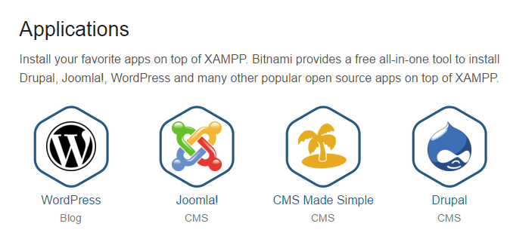

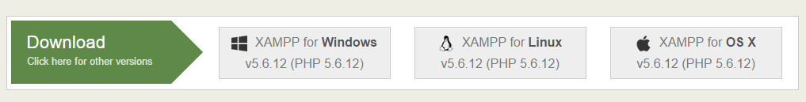
XAMPP
XAMPP is the most popular PHP development environment

Slide 6
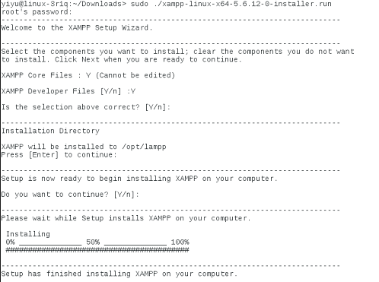
Install XAMPP
Root required
Default installation folder: /opt/lampp

Slide 7

Start XAMPP
Simple “start”, or “restart”

Slide 8
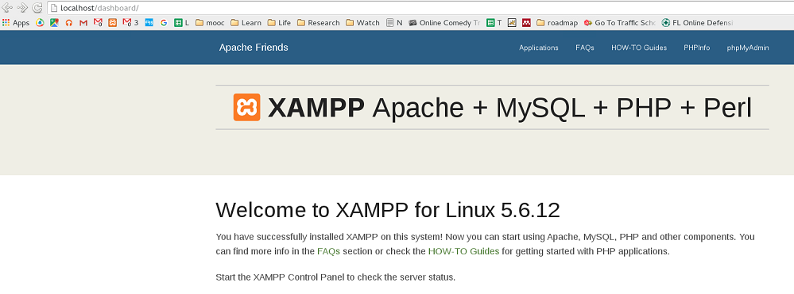
Using XAMPP
Visit http://localhost or http://youripaddress (this is the address that others can visit you)
Attention: you might also need to try to visit it from other PCs, and if you cannot visit it, most possibly because of the firewall

Slide 9
WordPress
Download WordPress from wordpress.org
Extract the files to /opt/lamp/htdocs/
Browser http://yourIPaddress/wordpress, and follow the instructions
You do not need to have your own domain, and let the website available to public (see Research ethics in lab guidelines)

Slide 10
What To Write
Daily progress (not really necessarily daily)
A place to record every steps (methods, parameters, tricky data processing) you have done, the analysis you conducted and the result you get
Weekly report
A summary of the progress during the whole week)
A plan of what you plan to do in the next week
Meeting Summary
after meeting with advisor
memo and plan

Slide 11
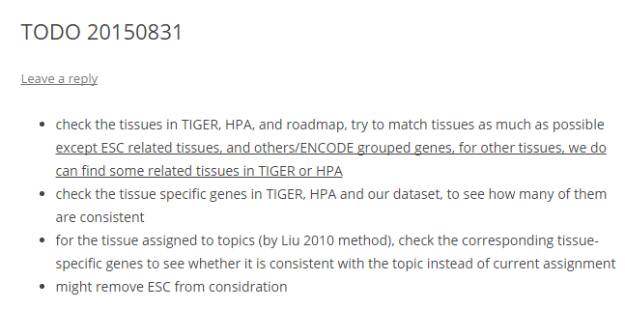
Sample of MEMO

Slide 12
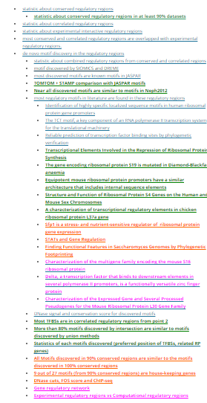
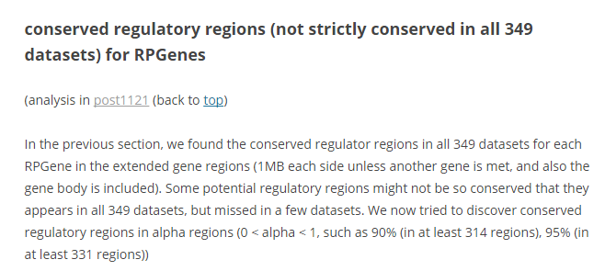
Sample post for a nearly finished project

Slide 13
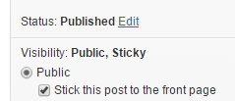
Tips
categorize your posts
Sticky post
Plugins
Cleverness To-Do List
BackUpWordPress
lots productivity plugins: plugins

Slide 14
Backup
Do remember to back up your report website every few weeks
Website files you put under /htdocs/wordpress
MySQL database
Sample Script:
tar cvf reportwebsite_$(date +%Y%m%d%H%M).tar.gz /opt/lampp/htdocs/wordpress/*
/opt/lampp/bin/mysqldump -u root -p databasename > research_$(date +%Y%m%d%H%M).sql

Slide 15


